Slide 1
CONTINGENCY TABLE
Handbook of Data Visualization - Chapter III.12

Slide 2
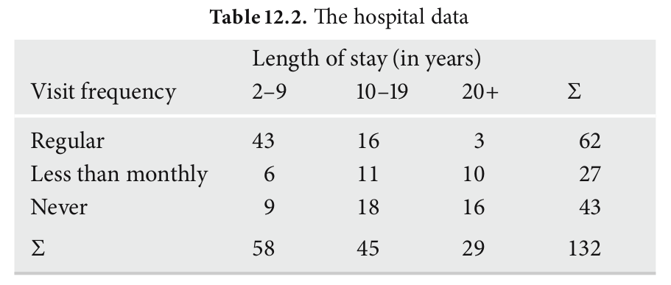
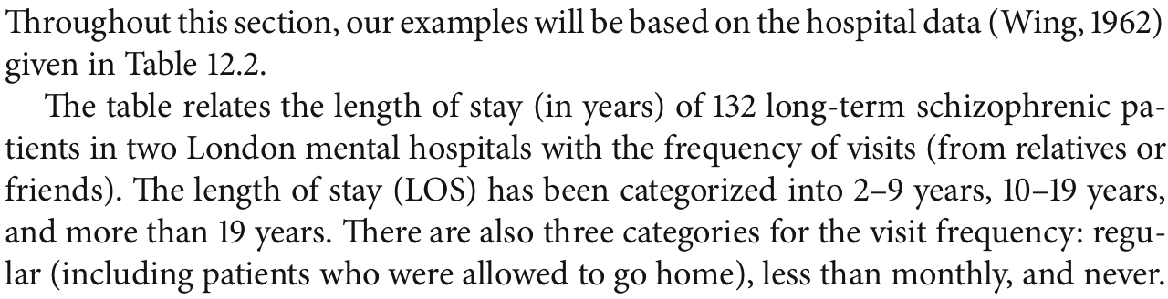

Slide 3
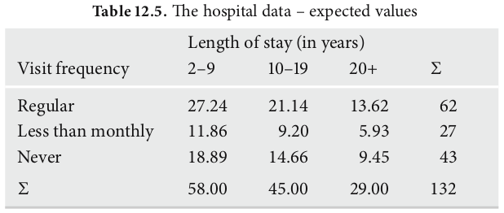

Slide 4
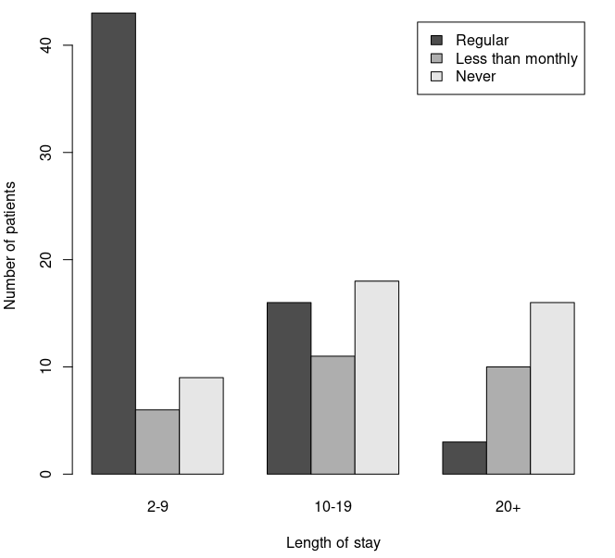
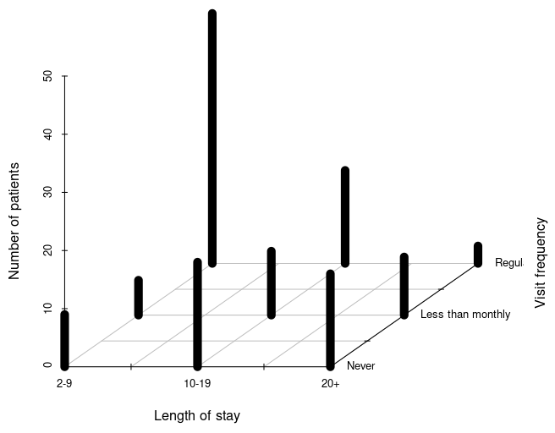
Grouped bar chart
3D bar chart

Slide 5
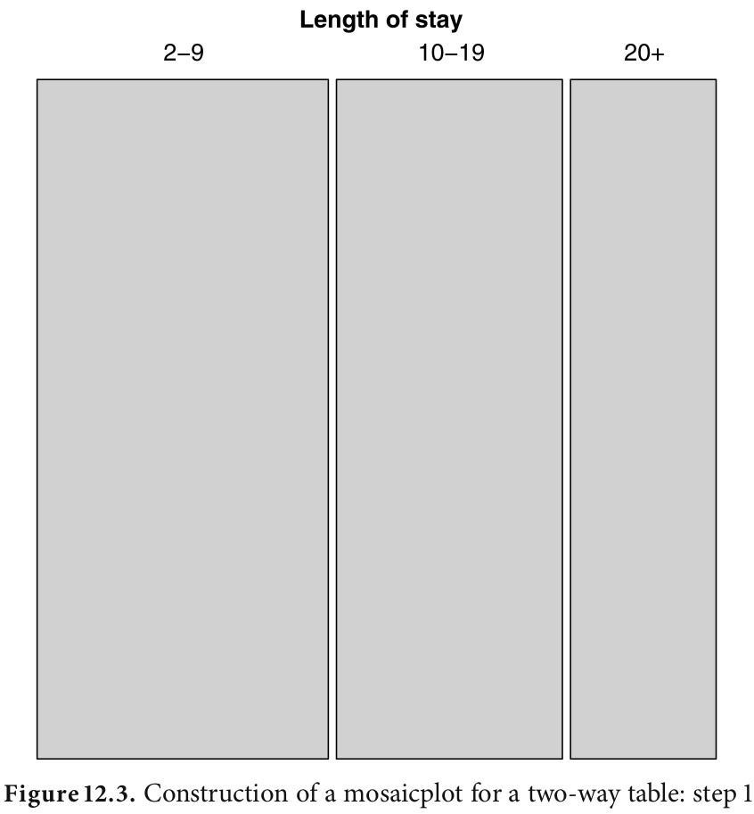
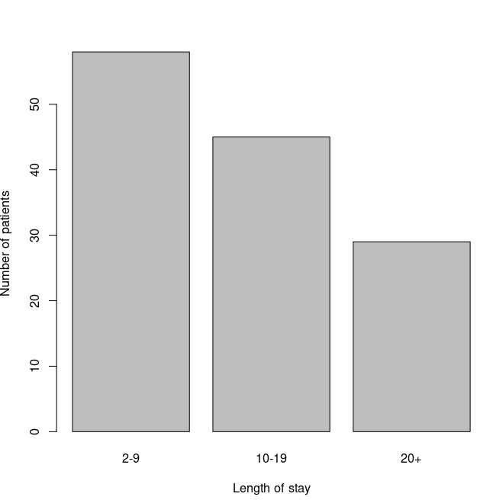
STEP 1: CREATING SPINE PLOT
SPINE PLOT
BAR CHART
Notes:
Step 1 consists of splitting a square according to the marginals
of one of the variables. To be consistent with the textual representation, we choose
LOS with vertical splits (see Fig. .). he result is similar to a bar plot, but in this
case the width rather than the height is adapted to visualize the counts for each level.
Such a plot is also called a spine plot (Hummel, ). From this plot, we see that
the number of patients decreases with the length of stay.

Slide 6
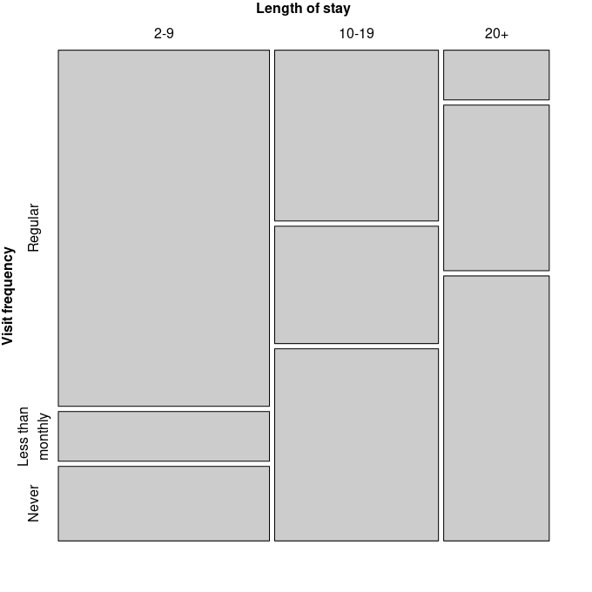
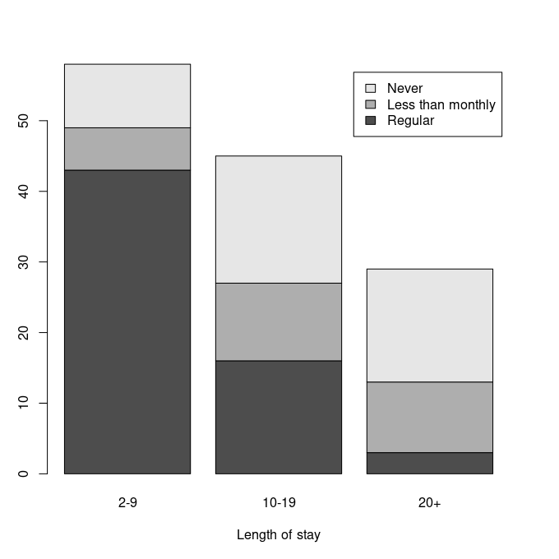
STEP 2: FURTHER SPLITTING
MOSAIC PLOT
STACKED BAR CHART
Notes:
Step 2 involves performing
further splitting in the other direction (resulting in horizontal splits) for the second
variable. his means that each vertical bar is split according to the marginals of the
second variable, given the ﬁrst variable (see Fig. .)

Slide 7
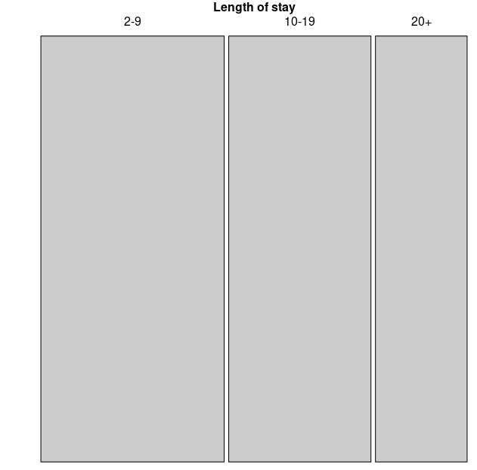
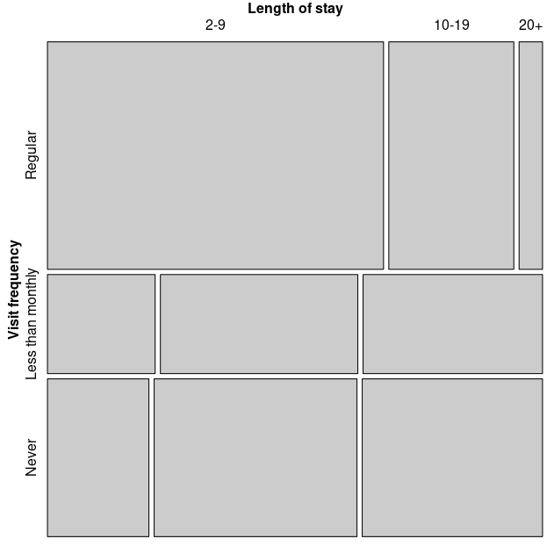
Notes:
Since mosaicplots are asymmetric by construction, the choice of the variable or-
der matters, as the ﬁrst splitting variable dominates the plot. In our example, if we use
“visit frequency” as the ﬁrst splitting variable, the impression obtained is very diﬀer-
ent compared to that of the previous mosaic (see Fig. .)

Slide 8
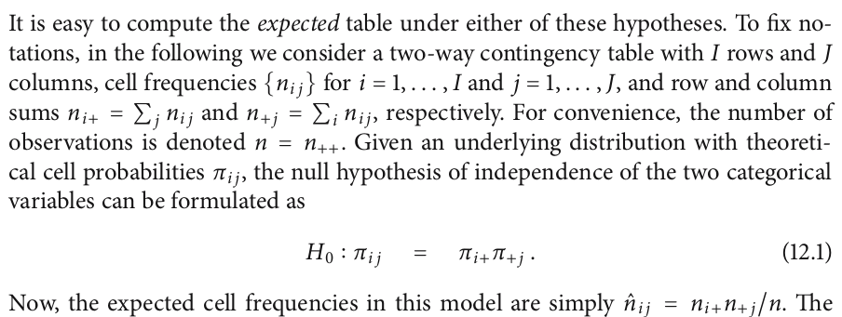
Visit frquency | 2-9 | 10-19 | 20+ | p
Regular | 43 | 16 | 3 | 62/132
Less than monthly | 6 | 11 | 10 | 27/132
Never | 9 | 18 | 16 | 43/132
P | 58/132 | 45/132 | 29/132 | 132
P(2-9&Reg)=P(2-9) * P(Reg)
= 62/132 * 58/132
= 0.2064
Expected value = 0.2064 * 132
= 27.24

Slide 10
Visit frquency | 2-9 | 10-19 | 20+
Regular | 43 (27.24) | 16 (21.14) | 3 (13.62)
Less than monthly | 6 (11.86) | 11 (9.20) | 10 (5.93)
Never | 9 (18.89) | 18 (14.66) | 16 (9.45)

Slide 11
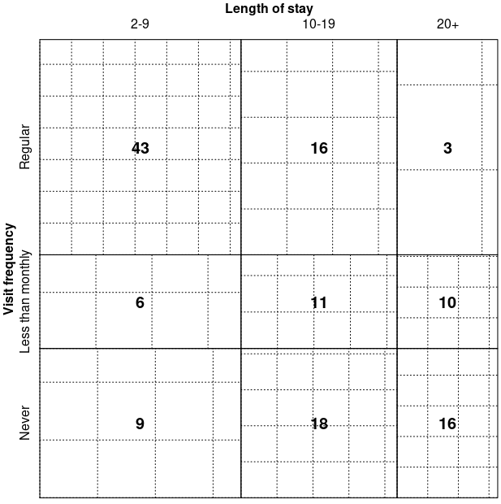
SIEVE PLOT
Visit frquency | 2-9 | 10-19 | 20+
Regular | 43 (27.24) | 16 (21.14) | 3 (13.62)
Less than monthly | 6 (11.86) | 11 (9.20) | 10 (5.93)
Never | 9 (18.89) | 18 (14.66) | 16 (9.45)

Slide 12
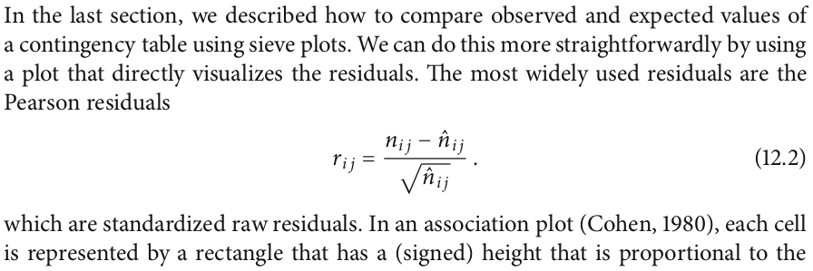
Visit frquency | 2-9 | 10-19 | 20+
Regular | 43 (27.24) (43-27.24)/√(27.24) | 16 (21.14) (16-21.14)/√(21.14) | 3 (13.62) (3-13.62)/√(13.62)
Less than monthly | 6 (11.86) (6-11.86)/√(11.86) | 11 (9.20) (11-9.20)/√(9.20) | 10 (5.93) (10-5.93)/√(5.93)
Never | 9 (18.89) (9-18.89)/√(18.89) | 18 (14.66) (18-14.66)/√(14.66) | 16 (9.45) (16-9.45)/√(9.45)

Slide 13
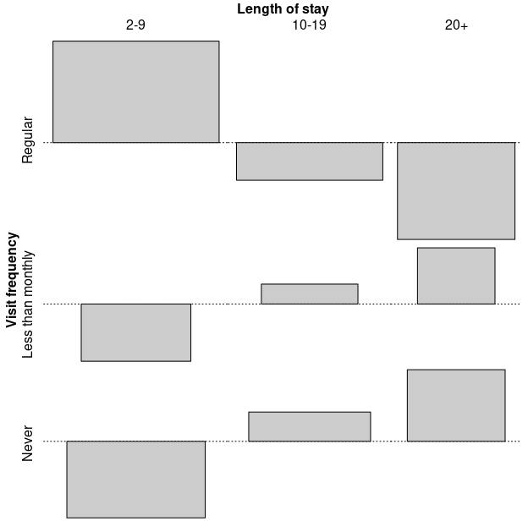
ASSOCIATION PLOT
Visit frquency | 2-9 | 10-19 | 20+
Regular | 43 (27.24) (43-27.24)/√(27.24) | 16 (21.14) (16-21.14)/√(21.14) | 3 (13.62) (3-13.62)/√(13.62)
Less than monthly | 6 (11.86) (6-11.86)/√(11.86) | 11 (9.20) (11-9.20)/√(9.20) | 10 (5.93) (10-5.93)/√(5.93)
Never | 9 (18.89) (9-18.89)/√(18.89) | 18 (14.66) (18-14.66)/√(14.66) | 16 (9.45) (16-9.45)/√(9.45)

Slide 14
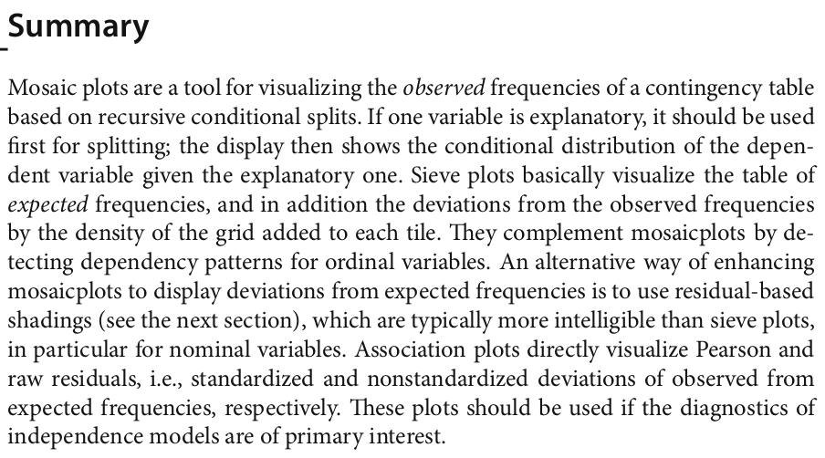

Slide 15
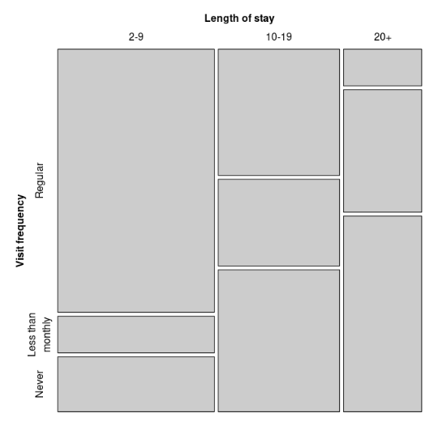
MOSAIC PLOT
SIEVE PLOT
ASSOCIATION PLOT

Slide 16
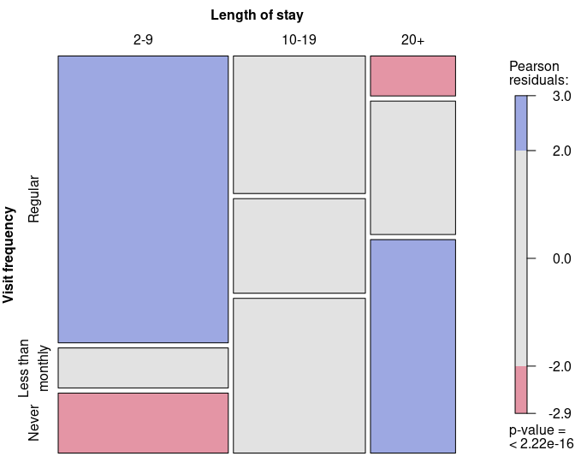
Using Colors for Residual-Based Shadings

Slide 17
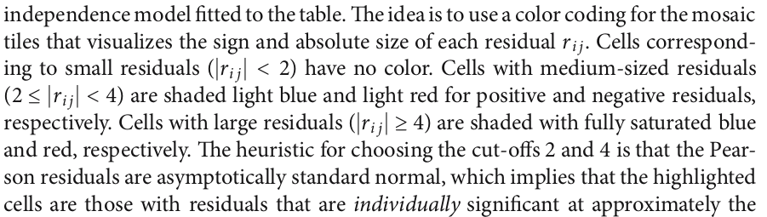

Slide 18
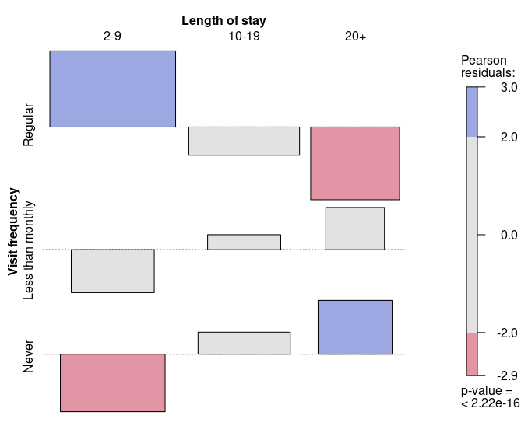

Slide 19
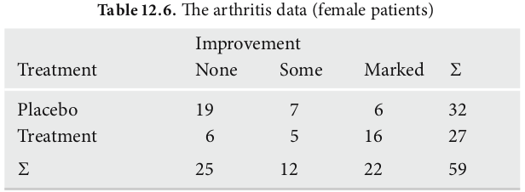
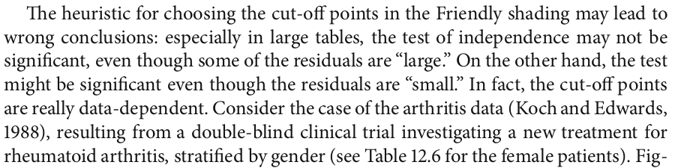

Slide 20
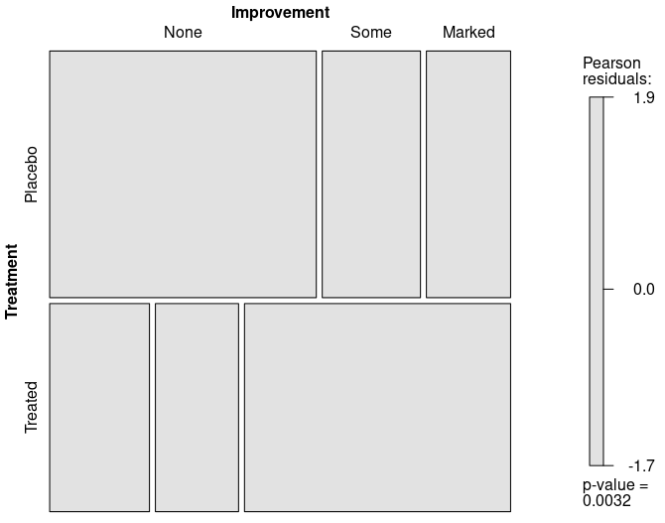

Slide 21
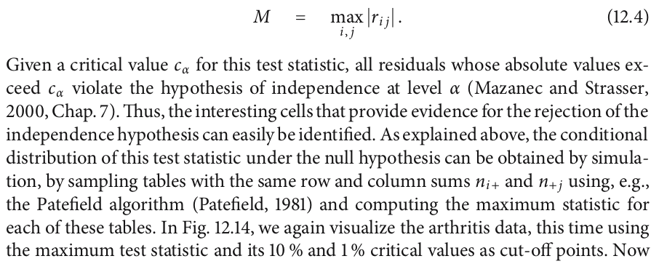

Slide 22
